Slide 1
COLLISION DETECTION AND AVOIDANCE SYSTEM FOR CAR
Name: DHARMENDRA YADAV
UID: 21BCS11791

Slide 2

Introduction
Presentation on Enhancing Automotive Safety through Advanced Collision Detection and Avoidance System for vehicles. This system aims to revolutionize vehicle safety and minimize the risk of collisions. We will explore the key features and benefits of this cutting- edge technology..

Slide 3

Current Safety Challenges
The increasing traffic congestion and driver distractions have led to a rise in road accidents.. Conventional safety measures are inadequate in addressing these challenges.. Advanced collision detection and avoidance systems offer a promising solution to mitigate these risks and enhance vehicle safety..

Slide 4
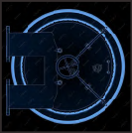
Key Components
The system integrates radar, lidar, and cameras to detect potential collisions. It employs real-time data processing and machine learning algorithms to analyze driving scenarios and predict potential hazards. This enables the vehicle to take proactive measures to avoid collisions.

Slide 5
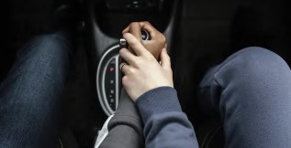
The system utilizes automatic emergency braking,, lane departure warning,, and adaptive cruise control to prevent collisions.. It also incorporates vehicle-to- vehicle communication to anticipate potential risks and take evasive actions..
These techniques collectively enhance the safety of vehicle occupants and
other road users..

Slide 6
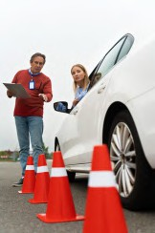
Benefitz of tke Syztem
The advanced collision detection and avoidance system offers enhanced vehiclle safety,, reduced collision rates,, and improved traffic ﬂow.. It also contriibutes to reduced iinsurance premiums and lower repair costs. These benefits make it a valluable addition to modern vehiclles..

Slide 7

Challenges and Limitations
Despite its advancements, the system faces challenges such as adverse weather conditions, technological limitations, and integration complexities. Addressing these challenges is crucial to ensure the system's reliability and effectiveness in diverse driving environments.

Slide 8
Future Developments
The future of automotive safety lies in autonomous driving and vehicle-to- infrastructure communication..
Integrating the collision detection and avoidance system with autonomous driving technology will further elevate vehicle safety.. Additionally,, leveraging vehicle-to-infrastructure communication will enhance real-time hazard detection and avoidance..

Slide 9
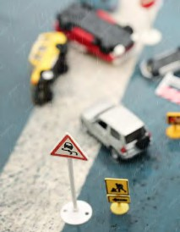
Conclusion
In concllusion, the advanced collision detection and avoidance system represents a significant leap forward iin automotive safety.. Its integration of cutting-edge technologies and proactive collision avoidance techniques holds the potentiall to save lives and reduce the iimpact of road accidents. Embracing this technology iis essentiall for a safer and more efficient transportation ecosystem..

